Slide 1

EuchreIQ Presentation

Slide 2
Project Contacts
Members
Gabriel Imes imesgw@mail.uc.edu
Travis Hurst hurstts@mail.uc.edu
Simon Feist feistsp@mail.uc.edu
Faculty Advisor
Fred Annexstein

Slide 3
Project Charter
Project Purposes
Create a Euchee program that performs a statistical analysis of its cards and determines the probability of each team’s chances of winning the round
Goals
Probability will be shown for chances of team winning the round, will update after each trick
Probability will be based off the user’s hand
Use bot to simulate large data set of automated games to accurately predict this probability

Slide 4
Intellectual Merits
Euchre is both a game of skill and luck. The more experience and individual player or duo have, the more advanced their techniques become.
Could training an AI and using the data from thousands of simulated games give reliable probabilities?
Will a new player to the game be able to learn and outperform an AI in a game such as Euchre with the correct prompts and tips?
Are there new strategies to consistently win at this game which have not been considered?

Slide 5
Broader Impacts
1. This application will be free to use and create an account for while offering unique and valuable features.
Goes against the current subscription-based trend in recent software
2. This application will not promote gambling and/or cheating at Euchre card games. Intended as a training or entertainment tool only.
The game will not allow the User to manually create hands to simulate a real game they are currently in, and there will be no money placed on games if multiplayer is added in the future

Slide 6
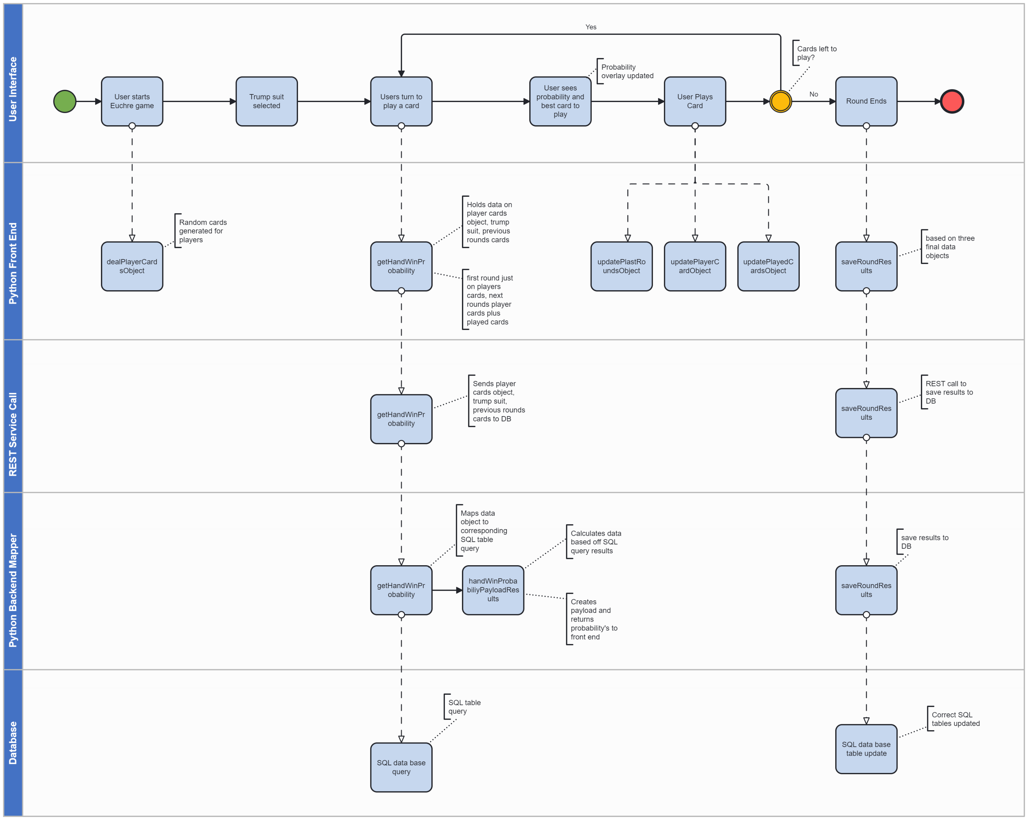
Design Diagram

Slide 7







Technologies
Web Design | Logic/Backend | Development Tools

Slide 8
Milestones
Semester/End-of-the-Year Goals | End Date
Research for all components is completed | 10/24/2024
Design specifications are completed, and development has been started | 10/31/2024
Initial development is complete and Initial euchre game is in a working state | 1/12/2024
Initial AI has been developed and ready for testing | 3/14/2025
Initial overlay of probabilities is added to the UI | 3/14/2025
Refine and validate | 3/28/2025

Slide 9
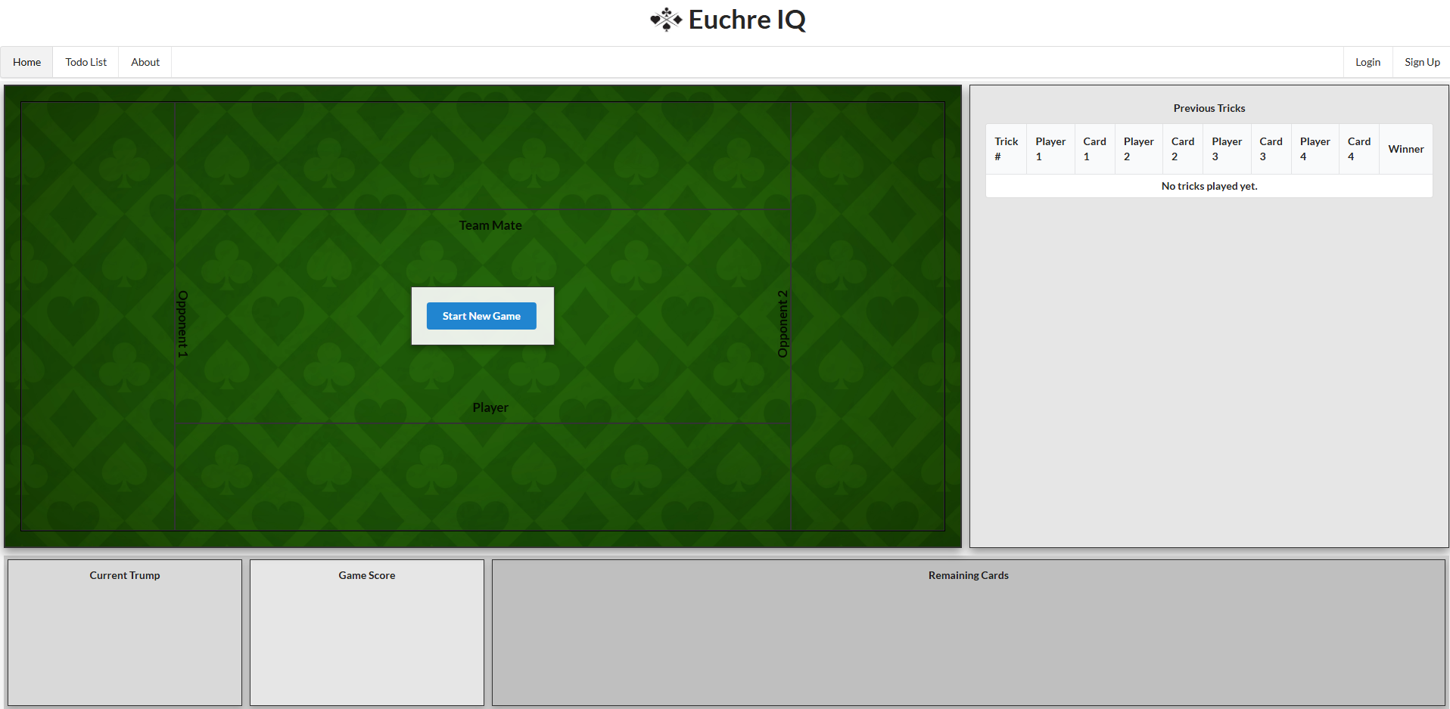
Results
Task List | Status
Specify and design system architecture | Done
Specify and design data model | Done
Research and document database software and data storage | Done
Research and document application and user interface framework | Done
Research and document AI/Automated bot integration | Done
Design database software and data storage tables | Done
Design and specify application user actions | Done
Design and specify admin view of application | Done
Develop application user interface(euchre game only) | Done
Develop database and data storage tables | In Development
Develop probability calculations from database tables | In Development
Develop admin view for application with views of relevant data | In Development
Develop AI/automated bot for initial euchre game | Not Done
Validate working model for initial euchre game | In Development
Validate correct data transferred to database | Not Done
Validate correct data returned from database to user interface | Not Done
Validate correctness of AI / automated bot actions for initial euchre game | Not Done
Develop overlay for probability calculations | Not Done
Refine AI/automated bot actions to increase probability outcomes | Not Done
Refine user interface to include additional features | Not Done
Refine admin view to give more value to data | Not Done

Slide 10
Challenges
Learning additional software languages, web application development, and database storage techniques
Creating a realistic game experience with correct game logic
Keeping the User Interface simple and intuitive while adding features
Making archived game data be useful for creating game probabilities and tips that increase application value
Staying close to original feature designs and intent while seizing opportunities to improve our application as they became apparent

Slide 11
Thank you

